Slide 1
IGNITE HOPE IN YOURSELF AND OTHERS
Declare the hope
Life is in the power of the tongue (Proverbs 18:21)
Synonyms
Notes:
This teaching is about how to ignite hope in yourself and others
Hope is a word that in its simplest verbal form means “to think, inspect or examine.” It is the Hebrew verb seber and the Aramaic verb sabar. It is used in this simple form in Nehemiah 2:13, where Nehemiah went out and “inspected” the walls of Jerusalem. In the next intensive form, seber means “to wait for, hope for, or wait on.”
Definition of hope is what you think about and have confidence will come to pass. Something you have to hold fast to.
Hebrews 3:6 APNT
Now Christ, as the Son, [is] over his house. And we are his house, if we hold fast the boldness and the boasting of his hope [savra] to the end.
Speak hope – we normally use the word confess when talking about the Word. I think DECLARE is a better word
Latin: de – thoroughly
Clarare – make clear
To say something in a solemn and emphatic manner (Well – I declare!!!)
Life is in the power of the tongue. Saying something out loud is good. I declare that….”all my needs will be supplied.” for example
It is the Spirit that makes alive. The body does not profit anything. The words that I speak with you are spirit and they are life. (Jn. 6:63 MGI)
Synonyms: proclaim, announce, make know, articulate, voice, pronounce – VENT

Slide 2
EXAMPLE OF ABRAHAM
Romans 4:17-20 APNT
As it is written: I have placed you [as] a father to a multitude of the Gentiles, before God in whom you believed, who makes alive the dead and calls those [things] that are not as though they are.
¹⁸ And without hope, he believed for the hope that he would be a father to a multitude of the Gentiles, as it is written: SO YOUR SEED WILL BE.
¹⁹ And he was not weak in his faith, considering his dead body that was one hundred years old and the dead womb of Sarah.
²⁰ And he did not doubt the promise of God as [one] lacking faith, but was strong in faith and gave praise to God.
Notes:
Romans 4:17-20 APNT As it is written: I have placed you [as] a father to a multitude of the Gentiles, before God in whom you believed, who makes alive the dead and calls those [things] that are not as though they are.
v. 17 Other translations: “things which do not exist as existing”, “calls into existence the things that do not exist.” Supernatural, not natural
v. 18 without hope he believed for the hope… NLT “even when there was no reason for hope.” Abraham received promise of descendants several times. God gave him reasons to hope:
Gen 12:1 To your seed I will give the land
Gen 13:15-17 Showed his the sand all around: And I will make thy seed as the dust of the earth: so that if a man can number the dust of the earth, then shall thy seed also be numbered. (Gen. 13:16 KJV) – his faith counted for righteousness
Gen 15:5 And he brought him forth abroad, and said, Look now toward heaven, and tell the stars, if thou be able to number them: and he said unto him, So shall thy seed be. (Gen. 15:5 KJV) – then made covenant. God guaranteed the promise
Gen 17:1 ff Neither shall thy name any more be called Abram, but thy name shall be Abraham; for a father of many nations have I made thee. (Gen. 17:5 KJV) (99)
Gen 17:10 This is my covenant, which ye shall keep, between me and you and thy seed after thee; Every man child among you shall be circumcised. (Gen. 17:10 KJV)
v. 19-20 gave praise to God (boasting) – all the ways he was declaring the hope Example: by his stripes (wounding)

Slide 3
FAITH – HOPE - WAIT
Romans 8:19-21 Phillips
The whole creation is on tiptoe to see the wonderful sight of the sons of God coming into their own. The world of creation cannot as yet see reality, not because it chooses to be blind, but because in God’s purpose it has been so limited– yet it has been given hope. And the hope is that in the end the whole of created life will be rescued from the tyranny of change and decay, and have its share in that magnificent liberty which can only belong to the children of God!
Notes:
Romans 8:18 For I consider that the sufferings of this time are not equal to the glory that will be revealed in us.
If we are suffering with him now in this time, it is nothing compared to the glorious time when we will be with him forever. We have the gift of the Spirit now so that we may be assured of what will come in the future (faith – water the seed). We can look expectantly (hope – think and expect) to what is to come and hold fast to the confidence (wait – to bind together, collect) that brings, knowing God will bring to pass his promises in EVERY WAY. What joy to know that we can wait with courage and steadfastness for the hope to unfold exactly as God said it would.
Romans 8:19-21 Phillips
The whole creation is on tiptoe to see the wonderful sight of the sons of God coming into their own. The world of creation cannot as yet see reality, not because it chooses to be blind, but because in God’s purpose it has been so limited– yet it has been given hope. And the hope is that in the end the whole of created life will be rescued from the tyranny of change and decay, and have its share in that magnificent liberty which can only belong to the children of God!

Slide 4
Romans 8:22-25 Phillips
It is plain to anyone with eyes to see that at the present time all created life groans in a sort of universal travail. And it is plain, too, that we who have a foretaste of the Spirit are in a state of painful tension, while we wait for that redemption of our bodies which will mean that at last we have realised our full sonship in him. We were saved by this hope, but in our moments of impatience let us remember that hope always means waiting for something that we haven’t yet got. But if we hope for something we cannot see, then we must settle down to wait for it in patience.
Notes:
p. 178 Romans 8:22-25 Phillips It is plain to anyone with eyes to see that at the present time all created life groans in a sort of universal travail. And it is plain, too, that we who have a foretaste of the Spirit are in a state of painful tension, while we wait for that redemption of our bodies which will mean that at last we have realised our full sonship in him. We were saved by this hope, but in our moments of impatience let us remember that hope always means waiting for something that we haven’t yet got. But if we hope for something we cannot see, then we must settle down to wait for it in patience.
We live in hope (not seen) and so we wait (entwine our hearts with God’s words as a rope)

Slide 5
Hebrews 11:1-3 APNT
Now faith is the persuasion concerning those [things] that are in hope, as if they had in fact happened, and the evidence of those [things] that are not seen.
2 And in this there is a testimony about the ancient [ones].
3 For by faith we understand that the ages were prepared by the word of God and [that] those [things] that are seen were from those [things] that are not seen.
Notes:
Heb 11:1-3 APNT Now faith is the persuasion concerning those [things] that are in hope, as if they had in fact happened, and the evidence of those [things] that are not seen.
2 And in this there is a testimony about the ancient [ones].
3 For by faith we understand that the ages were prepared by the word of God and [that] those [things] that are seen were from those [things] that are not seen.
God spoke, let there be light. Things appeared from something not seen. Persuaded, same as Abraham. Voicing the hope out loud – declare!
(v. 8-10) Abraham was seeking a city “for he was waiting for a city that had a foundation, whose craftsman and maker is God.” (Heb. 11:10 MGI)

Slide 6
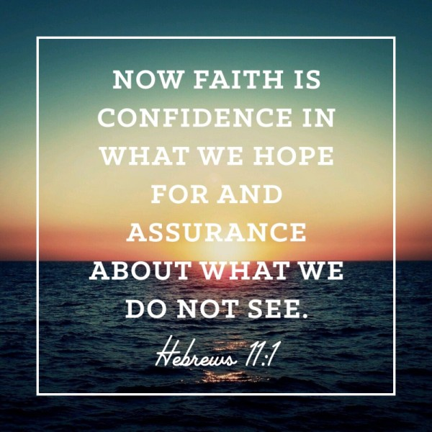
Notes:
Declarations for each day
Choose something that you do not see yet and write out a declaration and then say it every day.

